Slide 1



Naan Mudhalvan Detecting Spam E-Mails
Student Details: Name : KARTHIKEYAN.M NM Id : aut2211l304 college Name: Government College Of Engineering, Salem

Slide 2

Contents:
Abstract
Introduction
Aims & Objectives
Why people sent spam E-mails?
Services and Tools required
Proposed Solution
Project Architecture
Moral Development & Algorithm
Modelling and Project Outcome
Video of the Project
Future Scope
Conclusion
References
Links

Slide 3

Abstract:
Email spam classification is a critical task in today's digital world, where the amount of spam emails has increased dramatically. In this project, we propose to use machine learning (ML) and natural language processing (NLP) techniques to classify email messages as either spam or legitimate.
The project aims to develop an efficient spam classifier that can accurately identify and filter spam emails from legitimate ones. The dataset used in this project will consist of a large number of email messages with their corresponding labels (spam/ham).

Slide 4

Introduction: (Problem Statement)
Spam email is unsolicited and unwanted junk email sent out in bulk to an indiscriminate recipient list. Typically, spam is sent for commercial purposes. It can be sent in massive volume by botnets, networks of infected computers.
This is our problem Statement to do project about this topic.

Slide 5

Aim & Objectives:
The project aims to develop an efficient spam classifier that can accurately identify and filter spam emails from legitimate ones. The dataset used in this project will consist of a large number of email messages with their corresponding labels (spam/ham).

Slide 6

Why do people sent out Spam E-Mails?
Often, spam email is sent for commercial purposes. While some people view it as unethical, many businesses still use spam. The cost per email is incredibly low, and businesses can send out mass quantities consistently. Spam email can also be a malicious attempt to gain access to your computer.

Slide 7

Services and Tools required:
E-Mail Filtering Software
Machine Learning Models
Bayesian Filtering
Real-time Blackhole Lists(RBLs)
Sender Policy Framework(SPF) and DomainKeys Identified Mail(DKIM)
Content Analysis Tools

Slide 8

Proposed Solution:
Solution: Gather a dataset of labeled e-mails,where each e-mail is labeled as spam or non-spam(ham).Preprocess the text data to convert it into a format suitable for machine learning modals.This may include removing stop words,tokenization,and converting text to numerical representations.Extract features from the preprocessed text data.Common features include word frequency,TF-IDF(Term Frequency-Inverse Document Frequency),and N-grams.Choose a machine-learning model for spam detection.Common modals include logistic regression,Support vectorMachines(SVM) and Nasive Bayes classifiers.

Slide 9
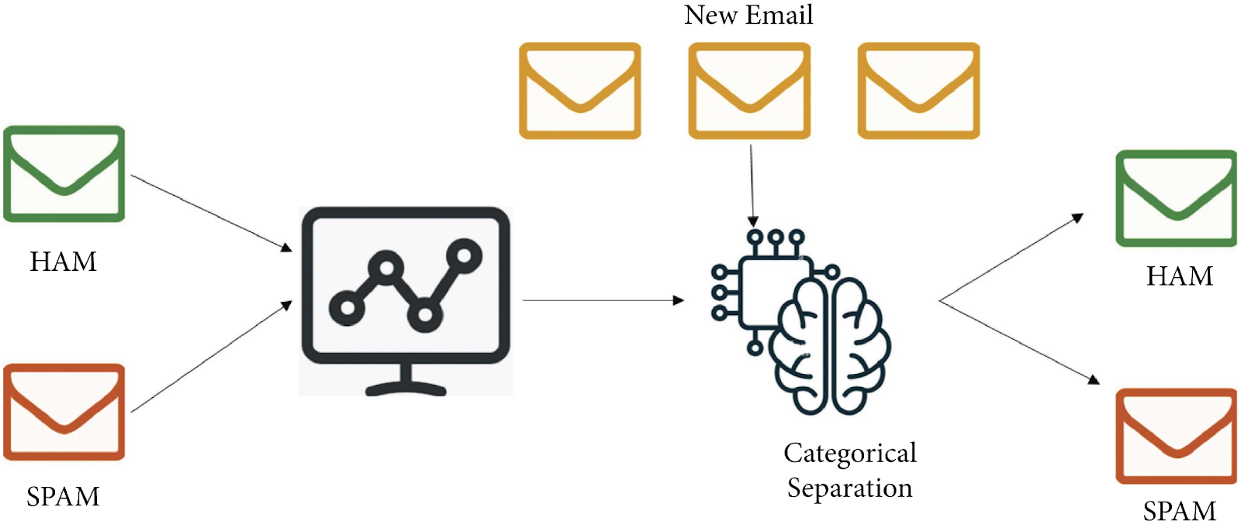
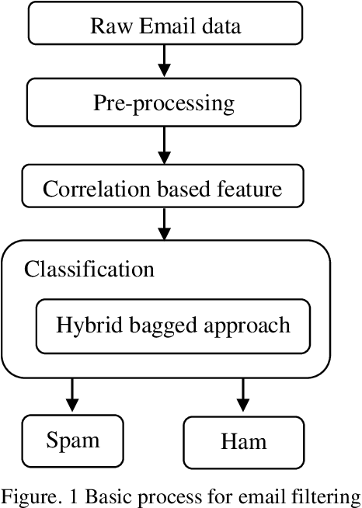
Project Architecture:(supervised learning)

Slide 10
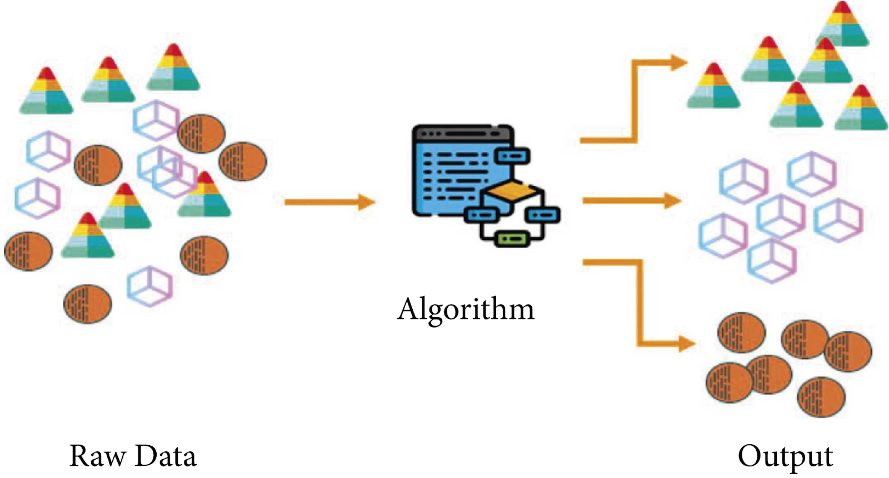
Project Architecture:(unsupervised learning)

Slide 11
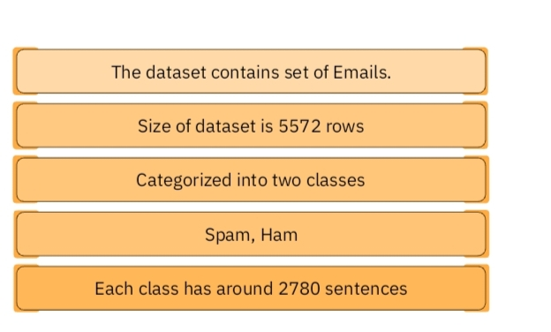
Moral Development & Algorithm:
Dataset Description:

Slide 12
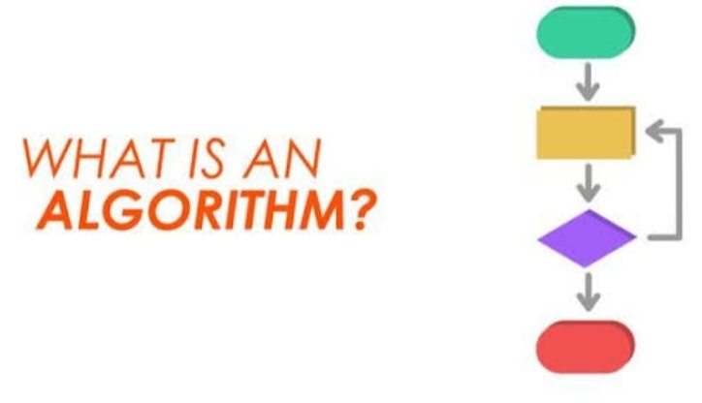
Moral Development &Algorithm:
Algorithm:
Input :E-Mail text data.
Output :Spam or non spam(ham) classification.
Algorithm steps:
Preprocess the email text data.
Extract features from the preprocessed text data.
Train a machine learning model on the extracted features .
Evaluate the trained model on a test dataset using metrices .
Fine-tune the model by experimenting with different techniques.
Deploy the trained model as spam detection system for real world use.

Slide 13
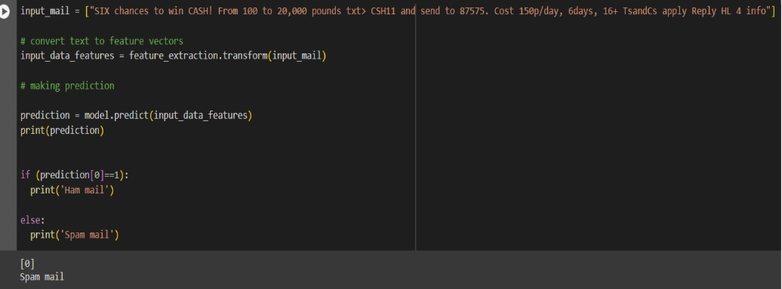
Modelling and Project outcomes:

Slide 14
Video of the Project:

Slide 15

Future scope:
Advanced Machine learning techniques:
Exlplore advanced machine learning techniqwues such asdeep learning,ensemble methods,and Natural language processing(NPL) to improve the accuracy and efficiency of spam detection.
Real-Time Detection:
Develop real-time spam detection systems that can quickly identified and filter out spam e-mails such as they are received,providing users with immediate protection.
User Feedback Integration:
Incoperate user feedback into the spam detection system to continuously improve its performance and adapt to new spamming techniques.

Slide 16

Conclusion:
In conclusion, our project on spam email detection using machine learning techniques has shown promising results in automatically identifying and filtering out unwanted e-mails.By leveraging machine learning models such as logistic regression,support vector mechanism(SVM) and Native bayes classifiers,we could effectively classify e-mails as spam or non spam(ham).
Moving forward ,there is potential to enhance this system by exploring advanced machine learning techniques,implementing real-time detection and incoperating user feedback.These improvements could further enhance the accuracy and efficiency of spam e-mail detecting systems ultimately improving user experience and security.

Slide 17

References:
https://www.coursera.org/
https://www.udacity.com/
https://www.Kaggle.com/leam
https://codelads.developers.google.com/

Slide 18


